Slide 1
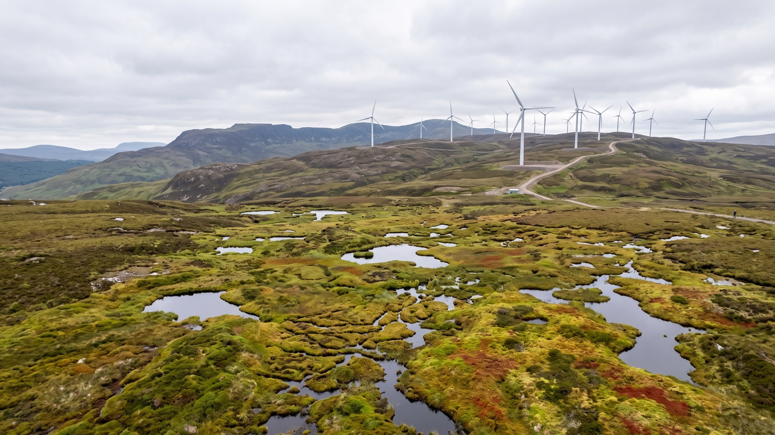
WEYLAND ENERGY
Sustainability Report 2026
Layout concept · Ravi Shah · September 2026

Slide 2
Concept: 'Building for the long run'
• Each chapter opens with a full-bleed photo from our sites
• Key figures in Sun on Deep Sea
• Data tables at the back, GRI index online
• A4 landscape PDF, accessible (PDF/UA)
WEYLAND ENERGY · Sustainability Report 2026 – layout concept
2

Slide 3
Key figures spread
1.2 Mt
71 ha
450
23
CO₂ avoided in 2025
peatland restored
employees
community projects
WEYLAND ENERGY · Sustainability Report 2026 – layout concept
3

Slide 4
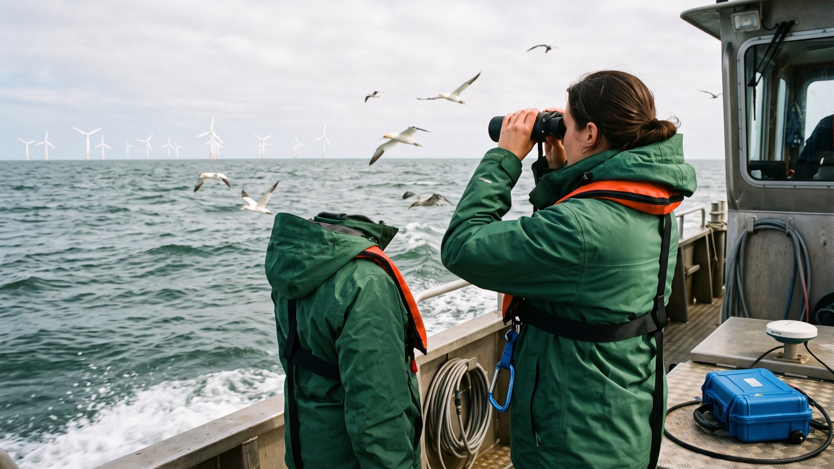
Chapter opener – nature
Marine surveys at Harrow Bay

Slide 5
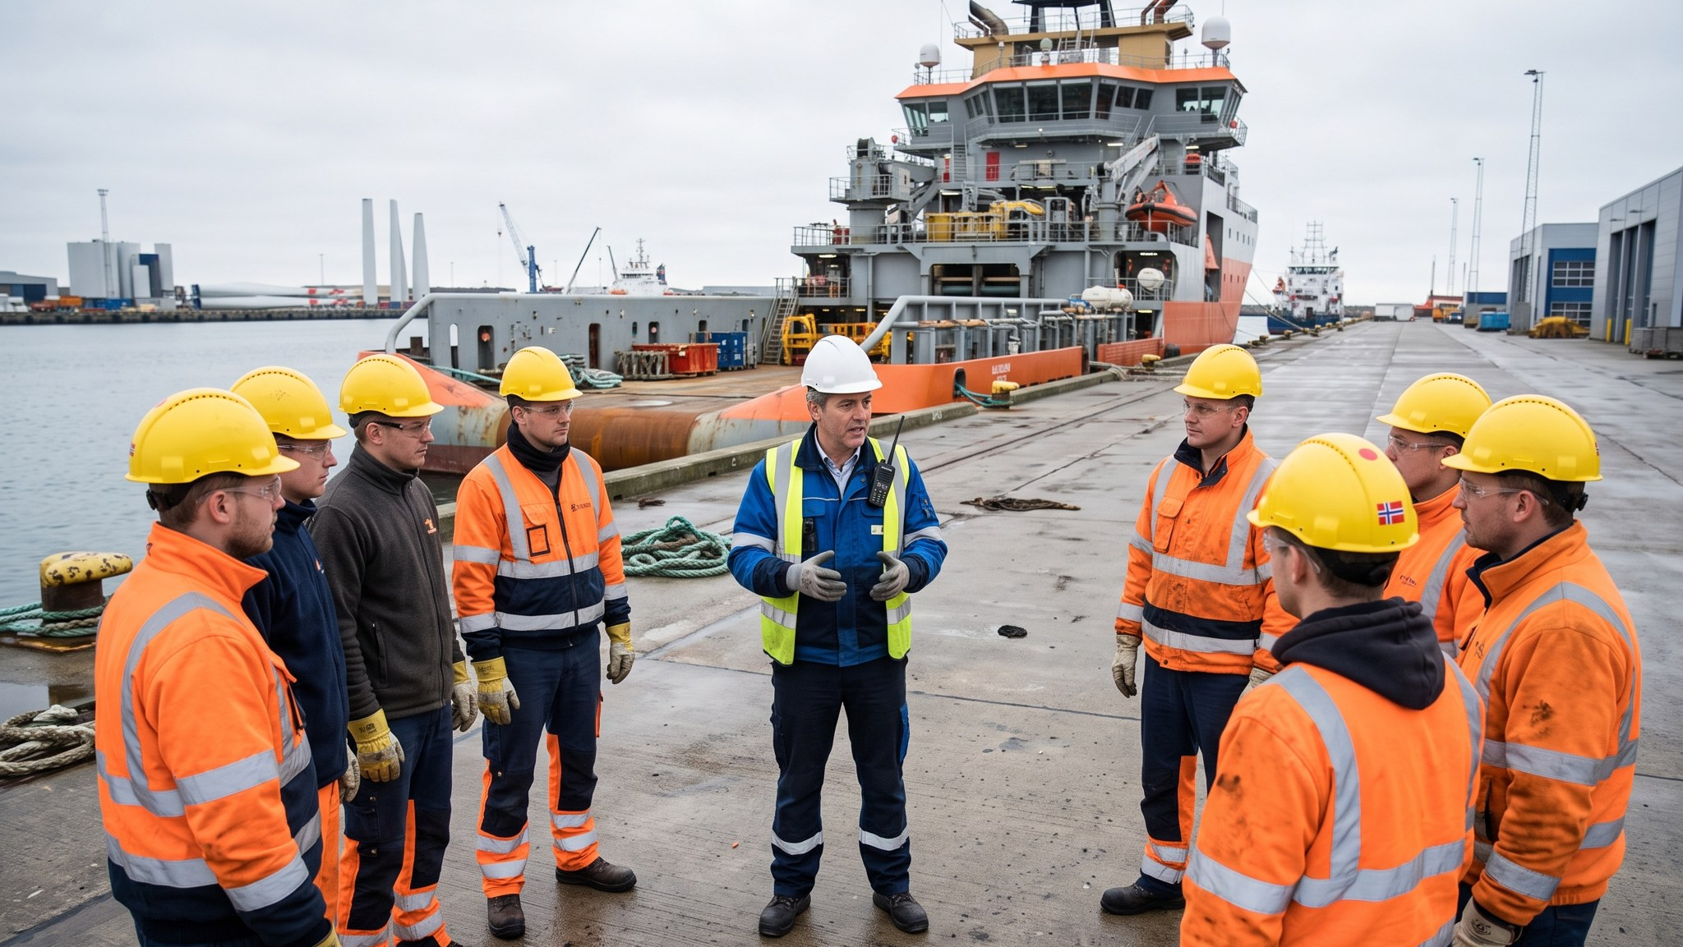
Chapter opener – people
Safety first, every morning

Slide 6
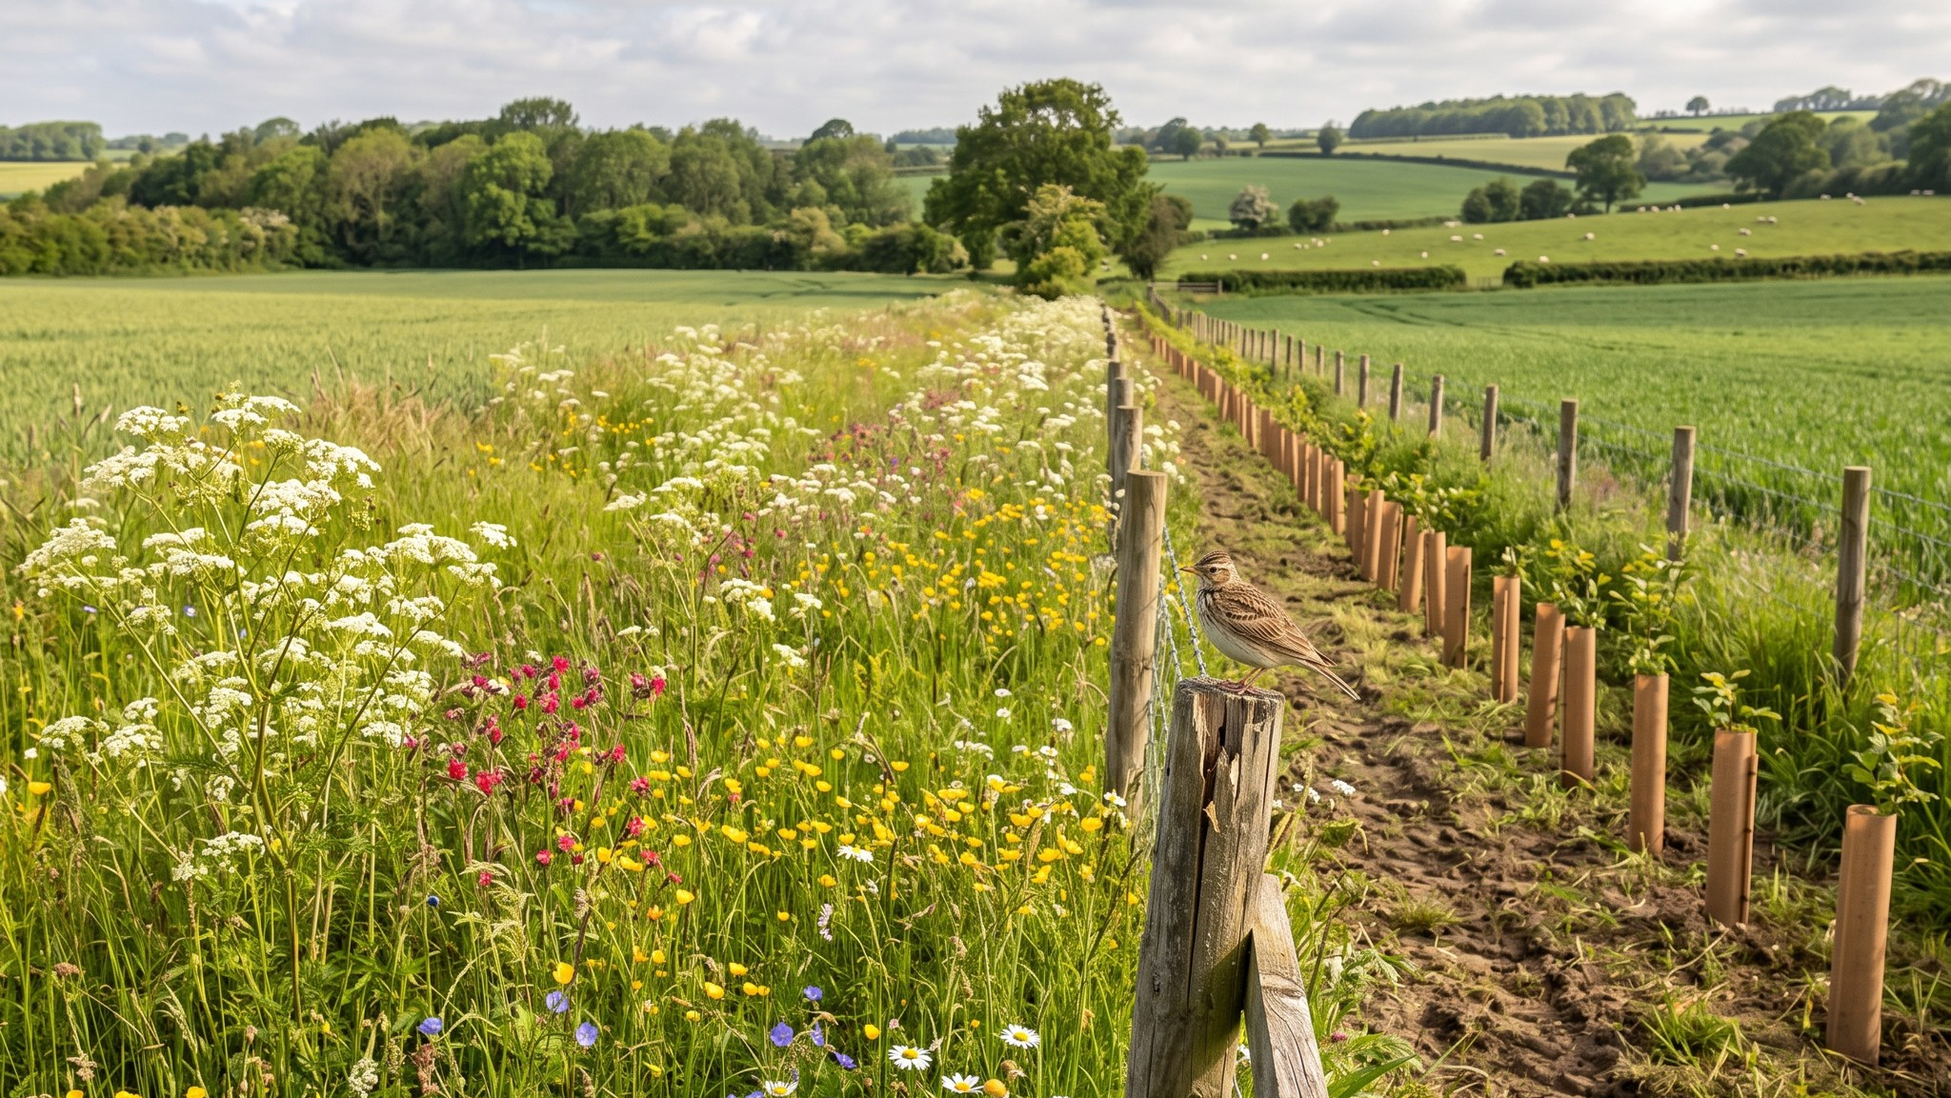
Chapter opener – land
Designing for nature at Millbrook

Slide 7
Timeline
When | What
Oct–Nov | Drafts v2
Jan | Full-year data
Feb | Typesetting, assurance
25 Mar 2027 | Publication
WEYLAND ENERGY · Sustainability Report 2026 – layout concept
7

